Slide 1

External Project Presentation of Computer Networking(CSE 3034) on Design and Implementation of a Peer-to-Peer Network for Time Synchronization using UDP: A Case Study with H1, H2, and DS
Presented by
Aswini Sanket Patnaik
(2141016180)
Abhisek Swain (2141019415)
Nikita Mohapatra (2141013257)
Mithilesh Swain (2141019416)
Suparna Biswas(2141002133)
Supervisor
Mrs. Diana Pradhan
Department of Computer Science and Engineering
Institute of Technical Education & Research (FET)
Siksha ‘O’ Anusandhan Deemed to be University, Bhubaneswar
Jan, 2024

Slide 2
Contents
Introduction
Problem statement
Methodology
Implementation
Result and Interpretation
Conclusion

Slide 3
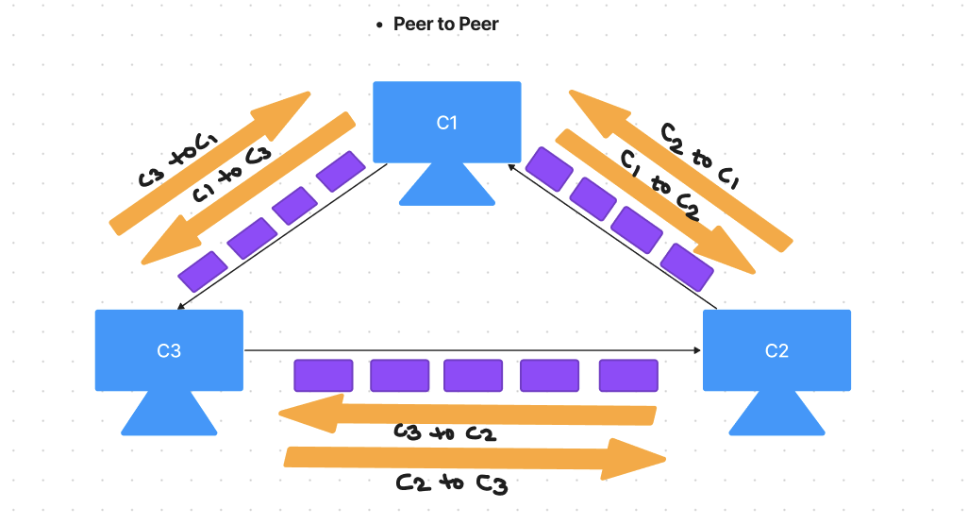
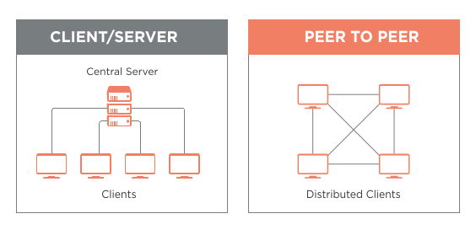
Introduction
Peer to Peer Network:
In P2P, every system is connected to every other systems in the network.
Here, C1 is connected to C2 & C3, C2 is connected to C1 & C3, C3 is connected to C2 & C1.
Here, in this network data are transferred in the form of packets are being transfer from one system to any other system.
This Photo by Unknown Author is licensed under CC BY-SA

Slide 4
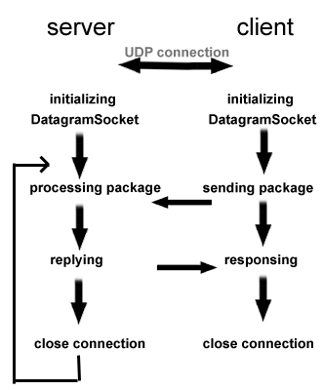
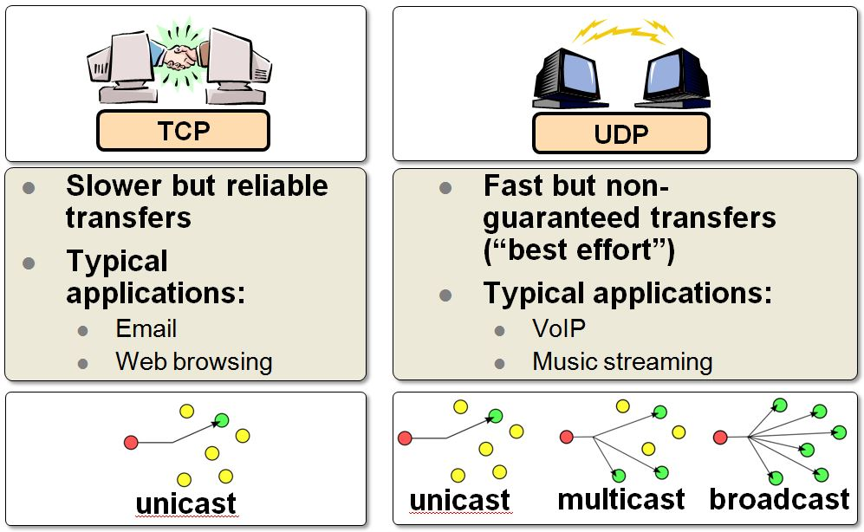
Introduction
UDP(USER DATAGRAM PROTOCOL)
It’s a connection-less protocol, does’nt need to establish connection before communication (un-like TCP PROTOCOL).
UDP sends the data in the form of packets ,and reads the data received in packets so it’s faster( un-like byte to byte reading in TCP protocol.
It doesn’t has any fixed order because all the packets are independent of each other (un-like TCP which rearranges the data packets in order).
As it doesn’t have any order and due to reading of messages in packets form, it is faster than TCP.
So it is used in case of Live Streaming where to stay live at the whole time is important, rather than ensuring whether our live stream is not laging.
Some important points to note:
UDP though fast but reliable as it doesn’t guarantee data transfer between peers, or machines.
It is used especially when ordering of data is not so important for us.
This Photo by Unknown Author is licensed under CC BY-SA
This Photo by Unknown Author is licensed under CC BY-SA-NC

Slide 5
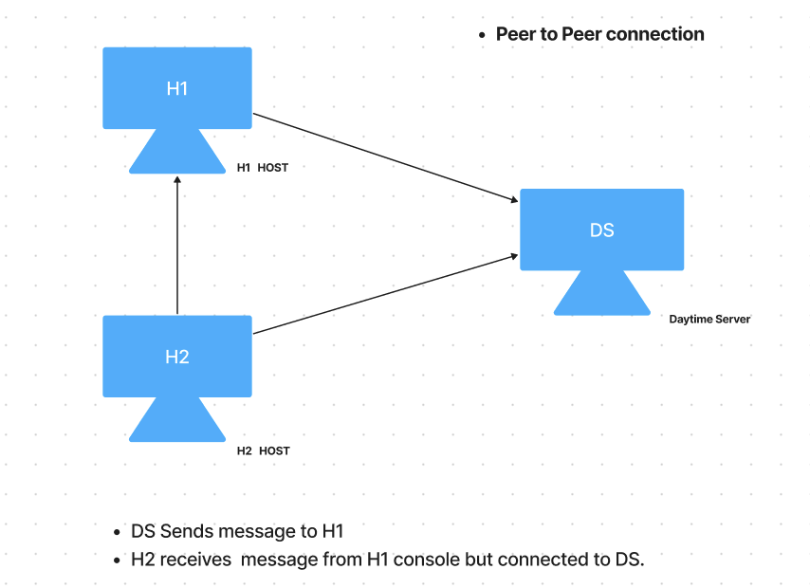
Problem Statement
Project goal & Statement:
We have to establish a peer-to-peer connection between 3 Systems( DS, H1 ,H2), where DS will be working as a DayTime Server. H1 and H2 both will be working as hosts.
H1 will ask the Date & Time from DS server and DS will be providing the data on the basis of request asked by H1. After H1 received the Data from DS, H2 will request the same data from H1 and we have to send the same data from H1, where H1 becomes Server for H2 now which was acting as a client while requesting DS.

Slide 6
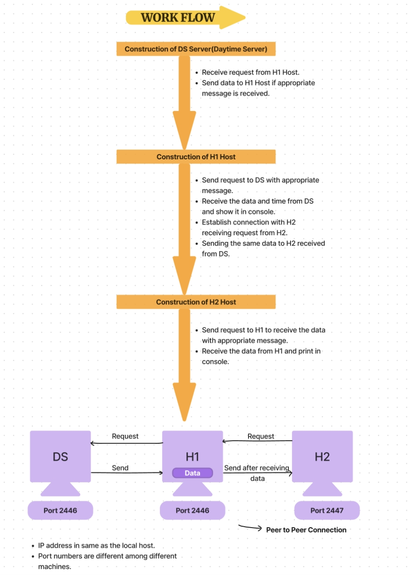
Methodology

Slide 7
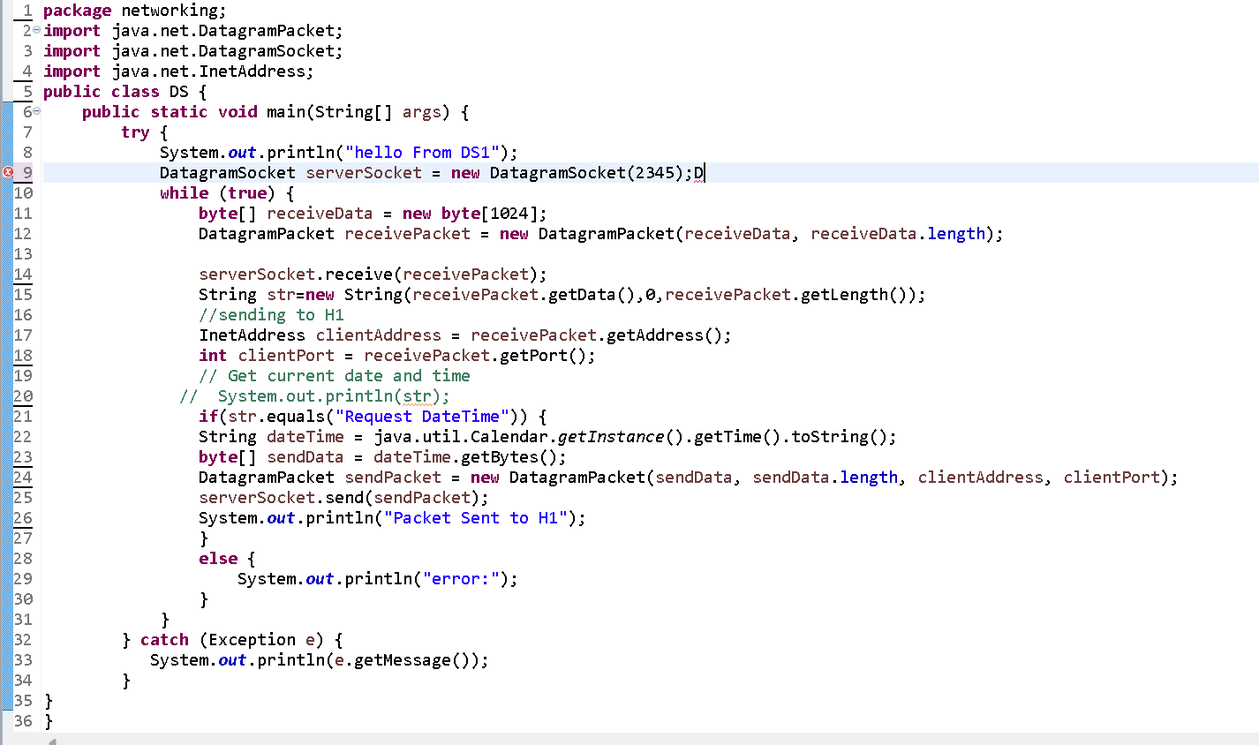
Implementation
Description of how project has been implemented:
In this problem first of all we have to make a DS Server using UDP protocols i.e. using DatagramSocket and DatagramPacket. DatagramPacket does two things.
1st is make the message ready to send the particular clientAddress containing port number to imply to which application of the client. 2nd is create an empty message area or say array in order to receive the data in the form of bytes from the clients or hosts.Also it accepts the messages in the form of bytes so we have to convert the stringtypes or any other types to byte convertible form.
DatagramSocket is mainly used to establish a connection between two or more peers, it contains two methods i.e. receive() & send() which is used to receive and send the messages( already made ready by Datagram Packet) between peers.
So, here in DS Server (1ST Machine) it firsts create a connection and make the Server to receive the message (made to get ready to accept) by DatagramPacket ,and after receiving the required DATE & TIME from your LocalSystem it than senDS it to H1 host using Socket’s send() method.
DS SERVER

Slide 8
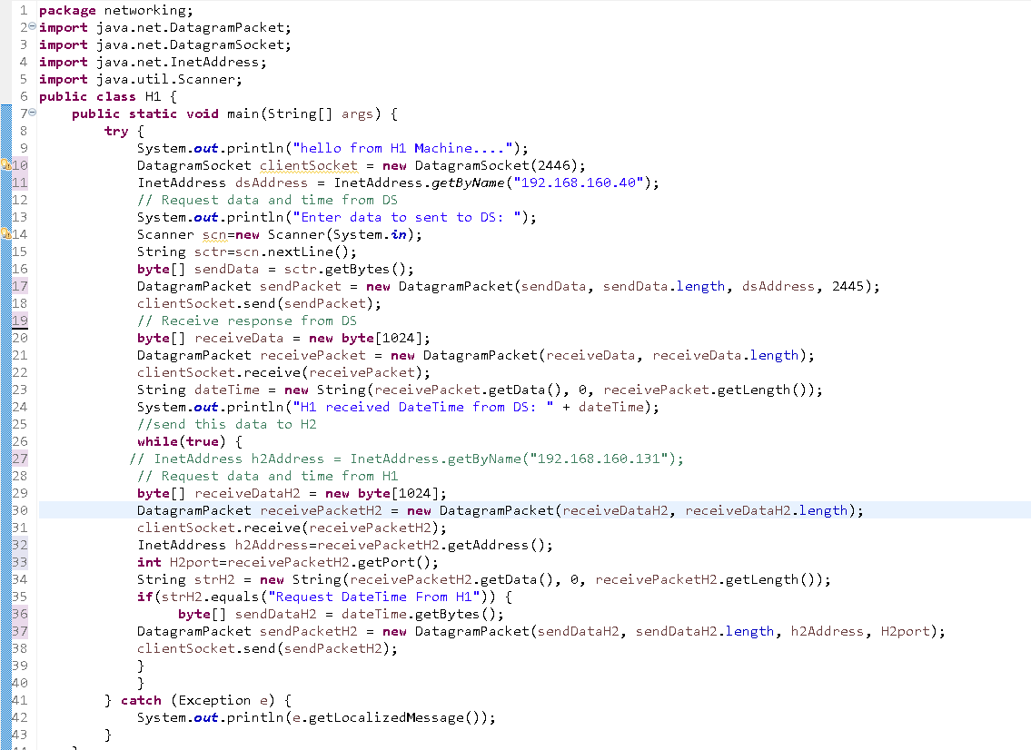
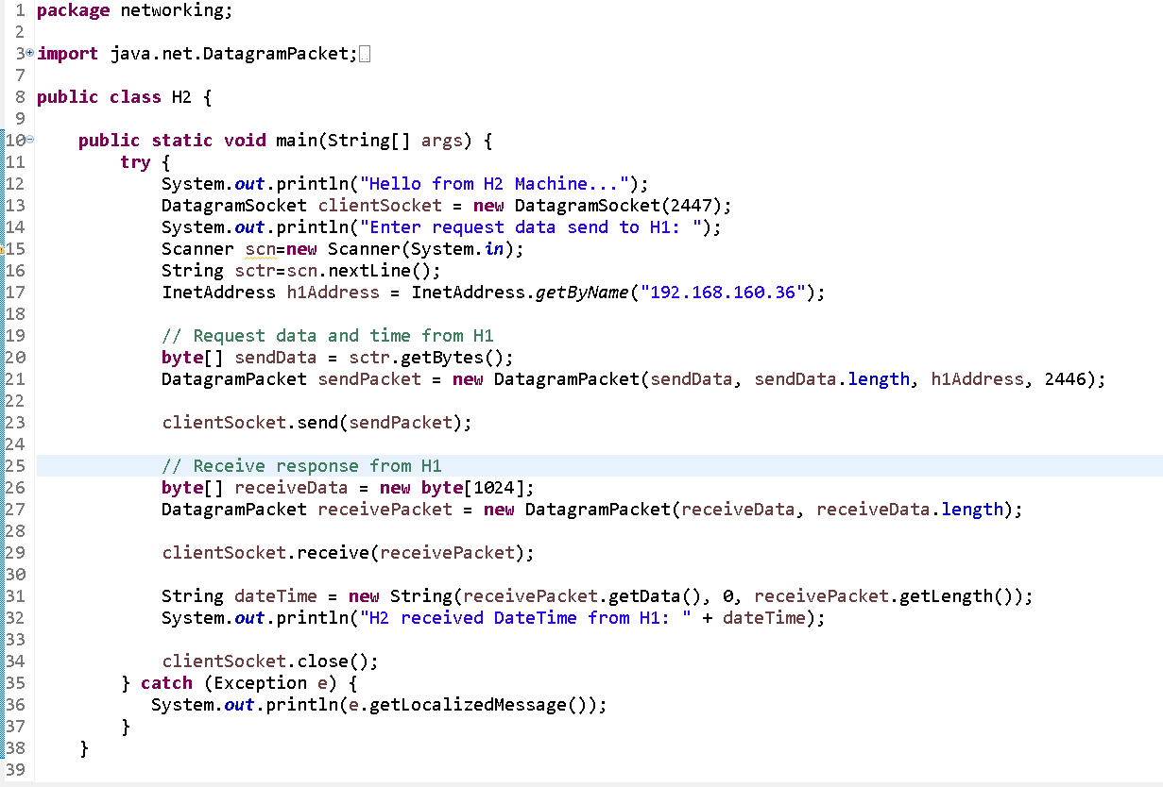
Implementation
H1 HOST
H2 HOST
Now H1 host is created, which will do 3 things , first is to send request to DS Server in order to access it by using send() method of Socket. Second is to receive the DATE & TIME from the DS and display it in the Console using receive() method of Socket. Third is again this DATE & TIME will be sent to H2 after printed in the console of H1 by using send() method of Socket.
Now finally the last host H2 is created which only does 2 things, first is to send request to H1 in order to access DATE & TIME by using send() method of Socket. Second is to receive the DATE & TIME from the H1 and display it in the Console using receive() method of Socket

Slide 9
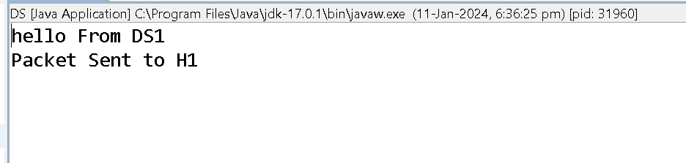
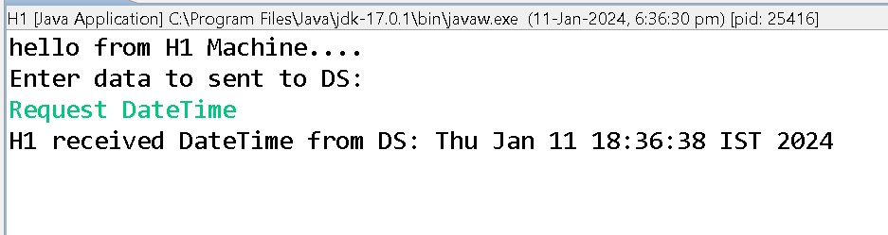
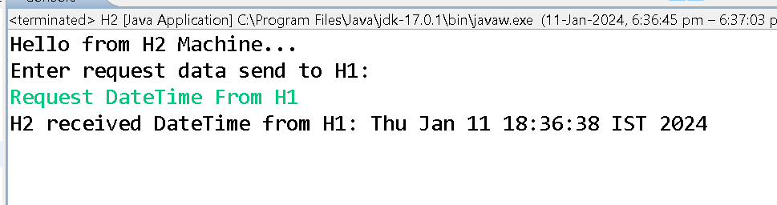
Result and Interpretation
OUTPUT
DS SERVER CONSOLE
H1 SERVER CONSOLE
H2 SERVER CONSOLE

Slide 10
Conclusion
In summary, the Java code presented establishes a simple peer-to-peer network involving three machines using UDP – H1, H2, and a Daytime Service (DS) provider. This project demonstrates the basic principles of network communication, where H1 connects to DS to fetch date and time, and H2 subsequently retrieves this information from H1. Despite its educational value, the code exhibits certain constraints, such as limited error handling, assumptions about localhost communication, and thread safety concerns.
For practical deployment, enhancements are necessary, including robust error handling, addressing port conflicts, scalability considerations, and improved data validation. Further, the code's modularity could be refined for increased flexibility and maintainability. This project provides a solid foundation for understanding UDP-based peer-to-peer networking but should be extended and refined to meet the standards of real-world applications.

Slide 11
References
[1] Computer Networks, Andrew S. Tannenbaum, Pearson India.
[2] Java Network Programming by Harold, O’Reilly (Shroff Publishers).
[3]www.computer.org (IEEE website ) & Oracle

Slide 12


Slide 13


